Slide 1
The Rainbow of Dementia Care: Understanding Communications with Those Coping with Dementia
Laura LaFauci

Slide 2
Goal
Attendees will:
Learn the difference between Alzheimer’s and dementia as well as the most common types of dementia.
Have a better understanding of dementia behaviors, characteristics, and best practice communication techniques.
Become aware of valuable resources and important planning tools.

Slide 3
Alzheimer’s vs Dementia
Dementia is an umbrella term used to describe a series of symptoms or syndrome which typically present when the brain is damaged by injury or disease. Alzheimer’s Disease is the most common form of dementia.
Symptoms involve progressive impairment in behavioral control, judgment, decision making, problem solving and memory which have a negative impact on daily life.
Dementia is not always permanent.

Slide 4
Alzheimer’s Disease
Alzheimer’s Disease is a progressive neurologic disorder that causes the brain to shrink and brain cells to die. The disease causes a continuous decline until it effects the individuals ability to function independently. The decline can last many years and end with a person forgetting simple functions such as swallowing and breathing, inevitably causing death.

Slide 5
Common Forms of Dementia
Alzheimer’s Disease
Vascular Dementia
Parkinson’s Disease Dementia
Traumatic Brain Injury (TBI)
Frontotemporal Dementia
Lewy Body Dementia
Korsakoff Syndrome/ Wet Brain
Huntington’s Disease
Notes:
Image: 1272275797

Slide 6
10 Early Warning Signs of Dementia
Memory loss that disrupts daily life
Challenges in planning or problem solving
Difficulty completing familiar tasks
Confusion of time or place
Difficulty understanding visual images and spatial relationships
New problems with words when speaking or writing
Misplacing things and losing the ability to retrace steps
Decreased or poor judgement
Withdrawal from family and/or social engagements
Changes in mood or personality

Slide 7
Rainbow of Dementia Care

Slide 8
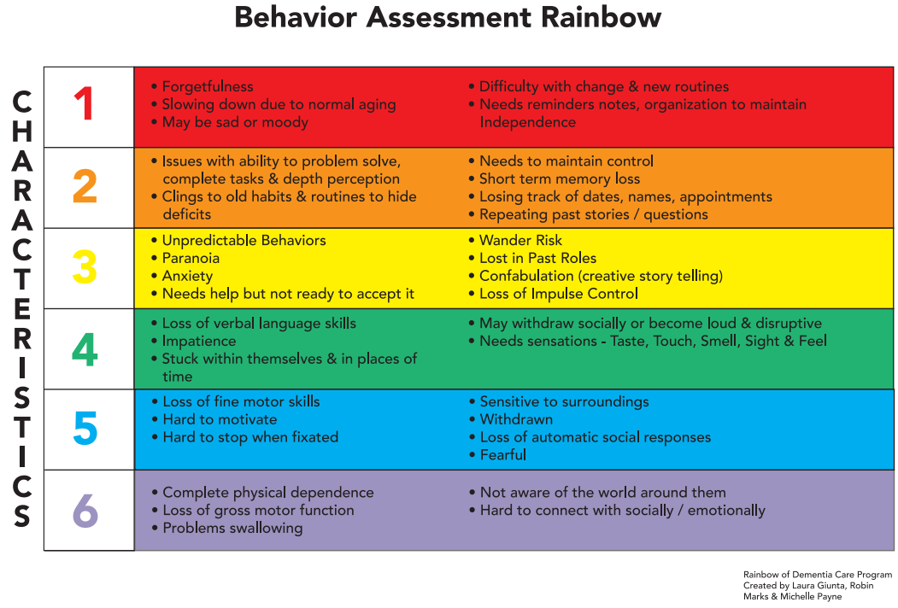

Slide 9
Possible Characteristics of Older Age
1
Forgetfulness
Slowing down due to normal aging
Difficulty with change and new routines
May be sad or moody due to change, loss
Needs reminders, notes and organizational tools to maintain independence

Slide 10
Early-Stage Dementia/Mild Cognitive Impairment
2
Issues with problem solving, completing tasks and depth perception
Clinging to old habits and routines to hide deficits
Fear of losing independence
Short term memory loss
Losing track of dates, names, appointments
Repeating past stories/questions

Slide 11
Moderate Stage Dementia
3
Unpredictable behaviors
Paranoia
Anxiety
Needs help but not ready to accept it
Wander Risk
Lost in Past Roles
Confabulation (Creative Story Telling)
Loss of impulse control

Slide 12
Care Techniques
1
2
3
Communicate: build rapport, ask questions, actively listen
Collaborate: use a team approach to create a meaningful daily routine
Respect and Empower: help them to feel useful, gain their permission, ask don’t tell, be a friend before a caretaker, provide choices, help to forge a legacy, be aware of personal space

Slide 13
Scenario 1
Mrs. Jones was doing well independently. She was moody at times and did not like change.
She became upset when family visited and moved things around in her home to “help” her organize.
Writing things down helped her to keep track of appointments and details.
Mrs. Jones was forgetting parts of conversations and had stopped visiting some of her friends.
Her daughter was concerned about her mothers behavior.
Her daughter believed she needed more social interaction and scheduled a bus to take her to the senior center in the afternoons.
Mrs. Jones became very angry and upset at her daughter’s interference.
How could her daughter have handled her concerns in a more productive way?

Slide 14
Advanced Directives
Healthcare Proxy
Living Will)
Power of Attorney
MOLST (Method of Life Sustaining Treatment) Form

Slide 15
Mid Stage Dementia
4
Loss of verbal language skills
Impatience
Stuck within themselves and in places of time
May withdraw socially or become loud and disruptive
Needs sensations-taste, touch, smell, sight and feel

Slide 16
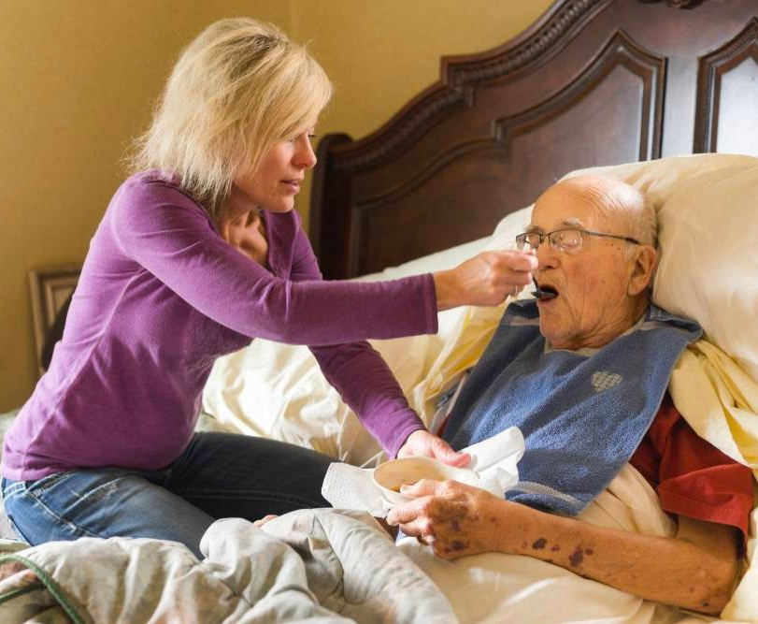
Severe Stage Dementia
5
Loss of fine motor skills
Hard to motivate
Hard to stop when fixated
Sensitive to surroundings
Withdrawn socially
Loss of automatic response
Fearful

Slide 17
Care Techniques
3
4
5
Respect and Empower: Ask for their help or cooperation, always utilize a team approach. (can we…. not you have to). Know when to walk away and try again another time. Be proactive in providing activity, if not you may not like what they will find on their own.
Protect: Secure environments, remove harmful substances, reduce risk for wandering/falling, avoid overstimulating environments.

Slide 18
Care Techniques
2
3
4
5
Validate and Redirect: be sure to acknowledge and be join your patient in their time and space. Listen closely and validate their feelings. Redirect by using what you have heard. Remember that there is often a deeper meaning.
Simplify Communication and Reinforce Understanding: Be slow, clear and precise in your communications. Use visual and verbal cues prior and during each task as well as when asking questions. Be very aware of their personal space, begin all messages at eye level and slightly off center. Provide less choices. Encourage eating by offering foods with stronger smells, salty/sweet flavors. The truth will not set you free with dementia. Therapeutic omission is a wonderful tool. Always remember to SMILE. Support- Mirror- Illustrate- Learn- Encourage.
.

Slide 19
Scenario 2
Marge is lives in an assisted living community.
She has mid stage dementia and needs assistance with toileting, bathing and dressing. The recreation director sent Marge back to her room to be changed.
Her caregiver was waiting for her.
The room was dark and her caregiver had on glasses and tightly pulled back hair.
As Marge entered the room her caregiver grabbed her waistband and began to lower her pants.
Marge began to scream and hit as if fighting for her life.
The caregiver asked Marge “What is the matter with YOU!” Marge continued to cry and fight as she screamed for help.
What could Marge have been thinking in this instance? How could the caregiver have met her needs while avoiding this upsetting interaction.

Slide 20
End Stage Dementia
6
Complete physical dependence
Muscle Atrophy or contracture
Loss of gross motor function
Problem swallowing
Not seemingly aware of the world around them
Hard to connect with socially or emotionally

Slide 21
Care Techniques
4
5
6
Reassure: provide support by holding a hand, softly stroking a cheek or shoulder, talk in song or rhyme, play soft music
Comfort: provide soft textures, sensory stimulation, use slow and rhythmic movements
Assist: with all activities of daily living (ADL)
Simplify: provide preferred foods without asking appropriate to dietary and swallowing needs.
Hydrate: this is important at every stage. In later stages it becomes more difficult for a patient to express the need.

Slide 22
Scenario 3
Max was in later stage dementia when he was brought to the hospital by ambulance.
Max was able to communicate his needs but was not oriented to time and place.
He hated hospitals and was extremely fearful he kept yelling that he wanted to go home.
The nurse on his unit repeatedly told him that he will not be going home and that he “had to” do what she said.
This interaction made Max extremely agitated. He asked her to stop or he would become violent. She dared him to do so and threatened him.
Max then hit the nurse which began a downward spiral leading to his demise.
How could the nurse have deescalated the situation by using the techniques we discussed?

Slide 23
Q & A
Laura LaFauci
Long Island National Aging in Place Council
631-383-4341
longislandny@ageinplace.org

